Slide 1
PASTA, PIZZA, PERSON
An analysis of digital presence
Kaden Franklin

Slide 2
Real Talk

Slide 3
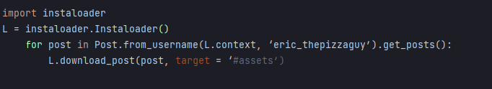
DATA
Python Library Instaloader
Pretty simple
Looks like this when it works, and you don’t have to run it from the command line:

Slide 4
DATA
Haar cascade classifiers.
Paula Viola and Michael Jones - “Rapid Object Detection using a boosted cascade of features”
OpenCV comes with classifiers for faces.
And even different perspectives of faces.
(and one for cats)

Slide 5
DATA – cont.
Making your own preset:
Can be run from command line
(hypothetically)

Slide 6
DATA – cont.
Making your own preset:
Can be run from command line
(hypothetically)
How hard can it be?

Slide 7
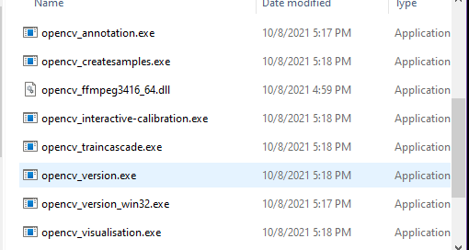
DATA – cont.
Making your own preset:
Can be run from command line
(hypothetically)
How hard can it be?

Slide 8
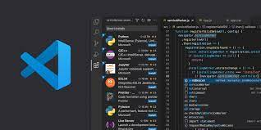

Slide 9
Algorithm
A whole lotta pseudo code
A function that does not successfully extract comments or likes from post.
Did not get any function to recognize a persons face across multiple images.

Slide 10
Algorithm
Sorted people into separate category from food.
Assimilated everything needed to create .xml presets.

Slide 11
Analysis

Slide 12
Does eric Like pizza?
He may
He may not

Slide 13
Who is eric’s favorite person?

Slide 14
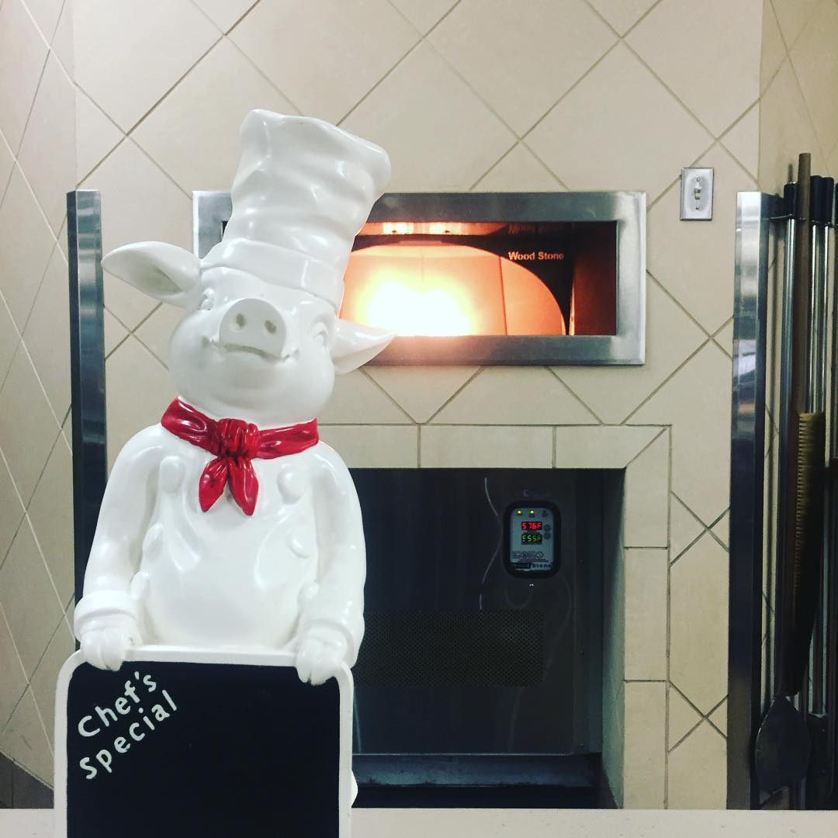
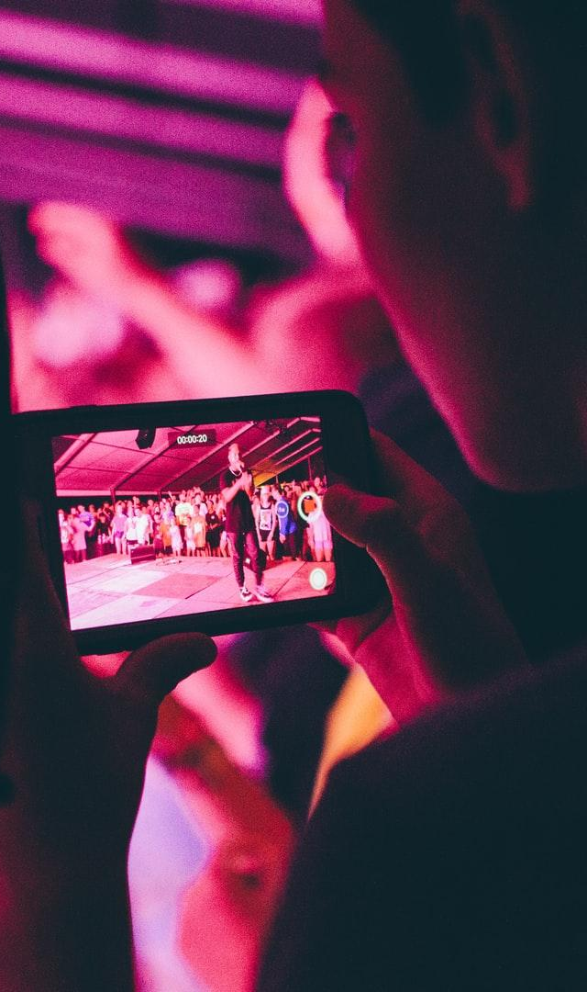

Slide 15

FUTURE WORK.

Slide 16
I PLAN TO DO NOTHING

Slide 17
I AM MOVING INTO THE WOODS

Slide 18
THANK YOU, GOODBYE

Slide 19
No seriously.
This was a really cool project and I am kind of mad at myself for not finishing.
https://github.com/KadenFranklin/Pizza_pasta

